Slide 1

AI for TB elimination: Insights from Wadhwani AI Global.
Prasaanth Balraj – AI Transformation Lead
Wadhwani AI Global

Slide 2
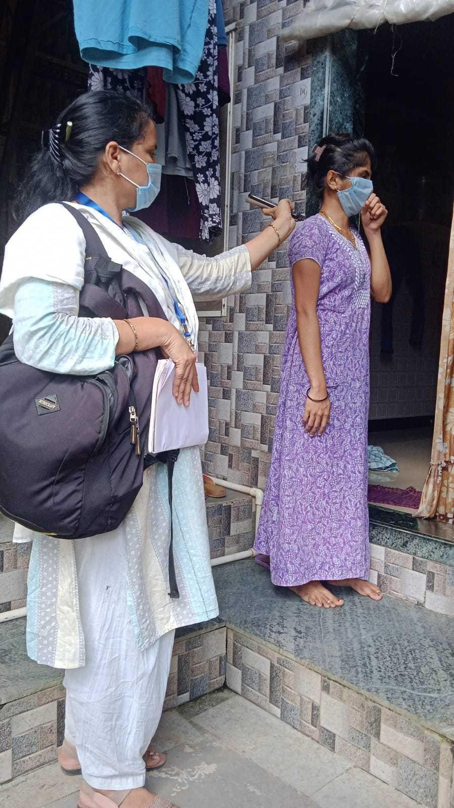

About Wadhwani AI Global
Mission
Vision
AI organisation purpose-built for public systems in the Global South, developing solutions that address critical challenges in healthcare, education, and agriculture.
Creating AI-powered tools that are accessible, affordable, and designed specifically for resource-constrained environments across developing nations.
Core Values
Innovation with purpose, equity-driven technology, and sustainable impact through collaborative partnerships with governments and communities.

Slide 3
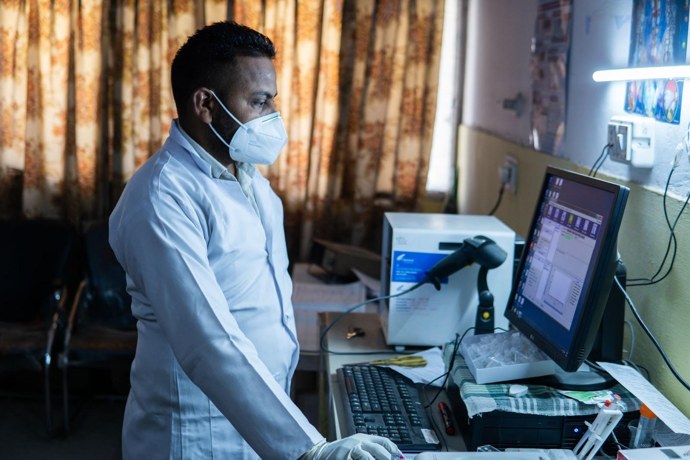
Practical Applications in TB
Lessons from India

Slide 4


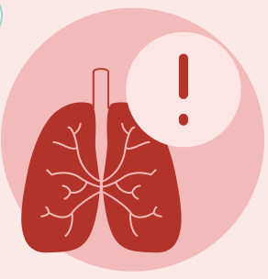






Cough Against TB
Analyzing cough sounds and factors in symptoms inputted by healthcare workers to identify presumptive pulmonary TB.
Tuberculosis-Screening
Basic Android smartphone required
The tool works offline and is scalable in rural community settings
Non-invasive and easy-to-use
Solution Overview
Solution Workflow
Deployment & validation
In India, nearly 65% of TB cases are missed by the public health system. Moreover, over 60% patients don’t seek care in spite of having symptoms, further widening the gap.
10 States in India deployed the tool in one year, resulting in the largest TB cough database in the world
Built on cough sounds from 16,375 individuals from health facilities
92% accuracy in identifying positive results (sensitivity) Solution deployed in high-risk community settings of Mumbai, Delhi and Hyderabad in Active Case Finding mode
Additionally, at health-care facilities in select districts of Nagaland, Kashmir, Chandigarh and Punjab (through NTEP)
Problem Context
A low-cost, high-sensitivity tool that screens for TB using the sound of a patient’s cough into a smartphone
INDIVIDUALS VISITING HWC
Solution Goal
AI Model
SYMPTOMS & COUGH AUDIO SAMPLES COLLECTED USING THE COUGH AGAINST TB APP
Input: Cough audio samples, symptom & comorbidity data
AI Model: ResNet-18 on mel-spectrograms + XGBoost tabular model
Output: TB likelihood score (suggestive/not suggestive)
INDIVIDUALS CONTACTED DURING HOME VISITS BY FLWs
Technical Architecture

Slide 5
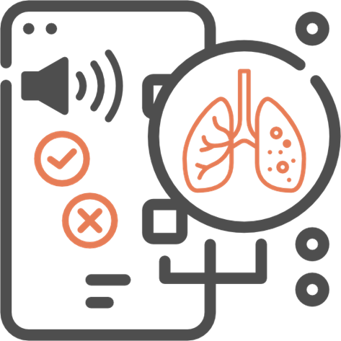
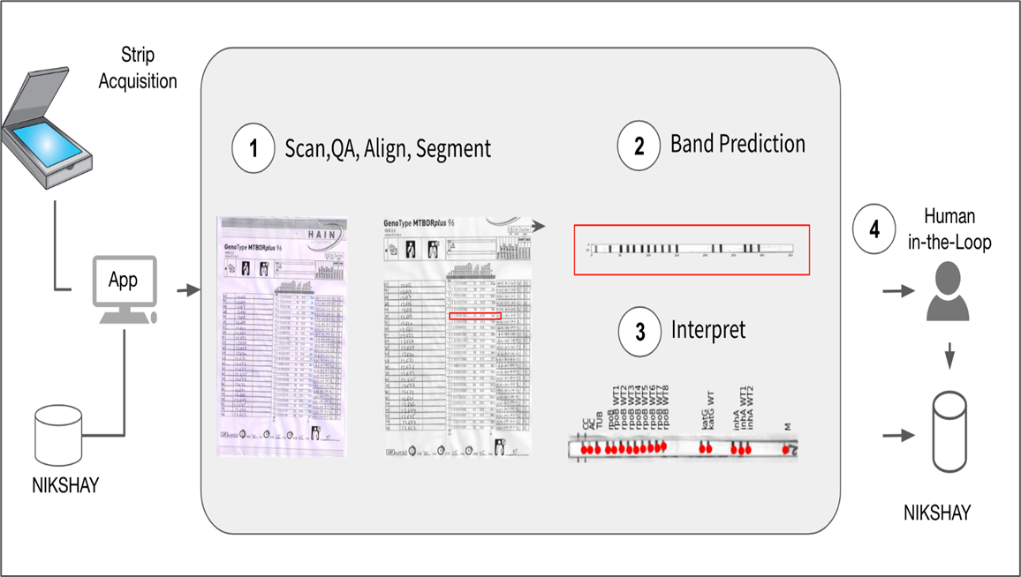
Line Probe Assay Interpretation
Automating drug-resistance detection to accelerate MDR-TB diagnosis in public health systems
Tuberculosis-Diagnosis
AI automation of LPA strip interpretation
Supports lab technicians with limited training
Reduces manual interpretation errors Designed for modular integration into public health lab workflows
Solution Overview
Solution Workflow
Deployment & validation
Manual interpretation of Line Probe Assay (LPA) strips is time-intensive, error-prone, and requires specialized training. Delays and inaccuracies in LPA reading contribute to late diagnosis and inappropriate treatment initiation for drug-resistant TB cases
Integrated into India’s Ni-kshay platform for national TB program scale-up
97.3% accuracy in detecting resistance for first-line drugs
100% accuracy for second-line drug resistance detection
Reduced LPA report turnaround time by up to 12 hours per patient
Deployed initially at key NTEP reference laboratories for validation phase
Problem Context
Enable faster, more accurate detection of drug-resistant TB by automating the interpretation of LPA strips using machine learning models, supporting frontline laboratory technicians and reducing dependency on centralized expertise
Solution Goal
Input: Digital images of LPA strips uploaded via web interface
AI Model: Image processing model trained to interpret band patterns for drug-resistance determination
Output: Automated classification into susceptible/ resistant categories for 1st line and 2nd line TB drugs
Mobile-compatible dashboard for result review and data submission
Integration with national TB program systems
Technical Architecture

Slide 6
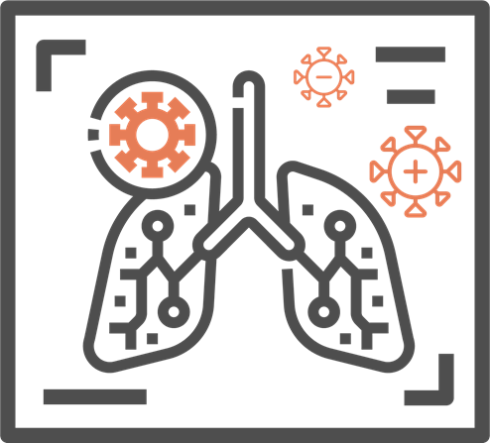
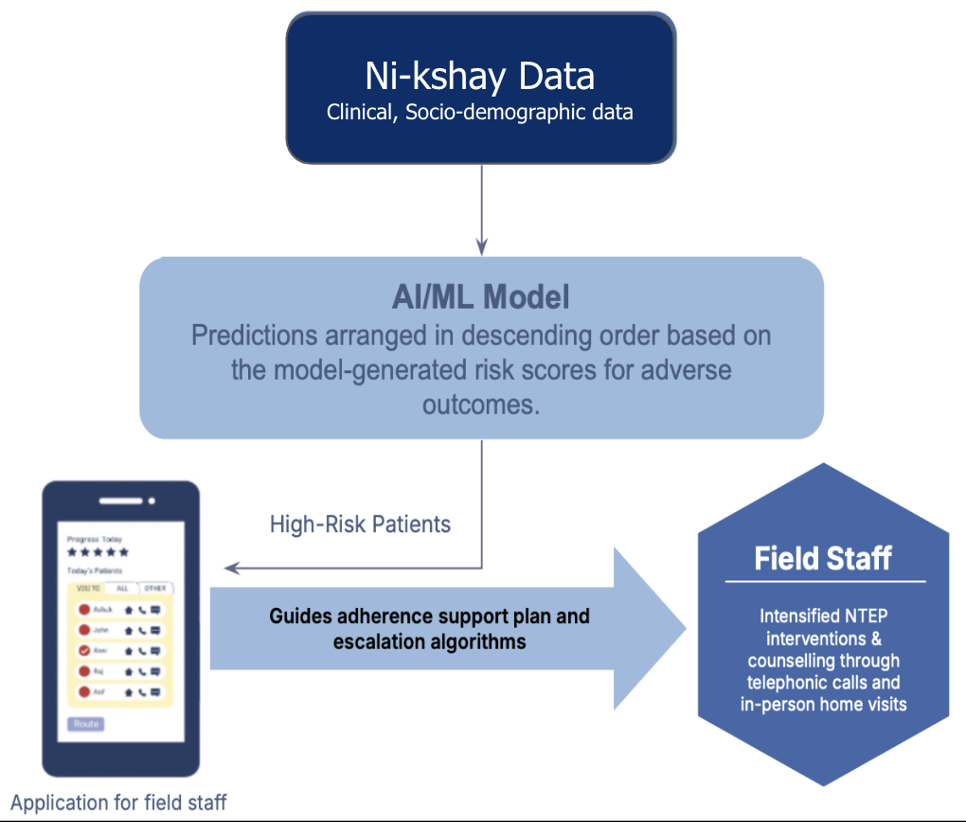
Prediction of Adverse TB Outcomes
Scaling AI risk prediction to prevent TB deaths and loss-to-follow-up in low-resource settings
Tuberculosis-Treatment
AI risk scoring at treatment initiation
Early flagging of high-risk patients
Actionable alerts for frontline staff
Seamless integration with TB platforms
Data-driven interventions to save lives
Solution Overview
Solution Workflow
Deployment & validation
As per the India TB Report 2024, 3% of TB patients are lost to follow-up and 4% die during treatment despite increased program efforts. LFU patients not only face higher risks of mortality and recurrence but also contribute to the spread of drug-resistant TB due to inadequate care at treatment initiation
Deployed across 16 geographies (14 States and 2 UTs), covering 128 districts
254,665 TB cases assessed for risk prediction
74,162 patients (29%) flagged as high risk for LFU or mortality
27% cumulative decline in adverse outcomes in deployment geographies
Integrated into Ni-kshay under CTD with technical oversight and programmatic monitoring
Trained ~1,000 NTEP state and district-level staff for field implementation
Problem Context
Enable early identification of TB patients at high risk of death or loss-to-follow-up through AI-based risk prediction at treatment initiation, empowering health workers to prioritize interventions and provide targeted support for improved outcomes
Solution Goal
Input: Patient demographic and clinical details from Ni-kshay at treatment initiation AI Model: Gradient-boosted decision tree predicting risk of loss-to-follow-up or death, classifying patients as high or low risk Output: Risk scores displayed in Ni-kshay for health worker action
Technical Architecture

Slide 7
Thank you

